Slide 1
PhD Research
KADA Workshop Mar2023
Winter Vacation Activity
Myat Toe
202281103

Slide 2
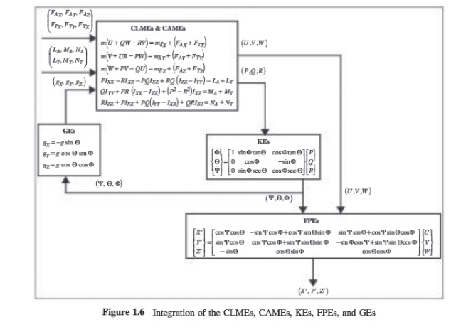
Aircraft Dynamics
Aircraft Dynamics From Modeling to Simulation (Myat Toe & Gyeong Min)
Aircraft Equation of Motion (Finished)
Basic Concept of Aerodynamic Modeling (Finished)
Modeling of Longitudinal & Lateral Aerodynamic Forces and Moment (Finished)
Flight Simulation with Dynamics (On Going)

Slide 3
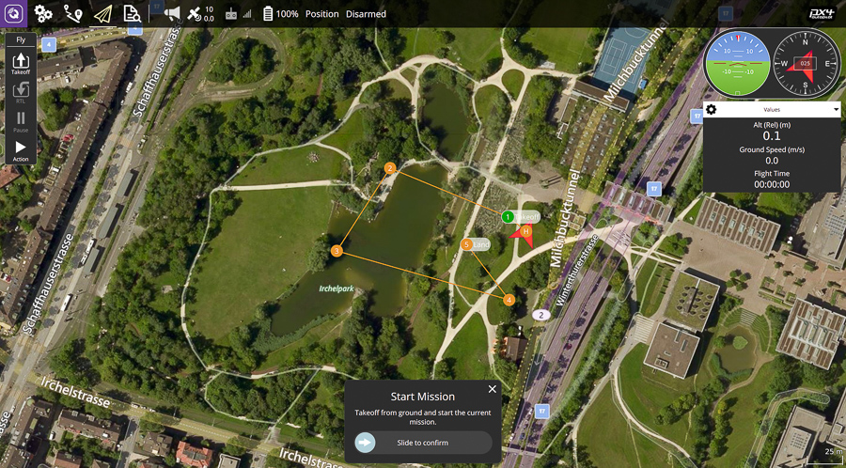
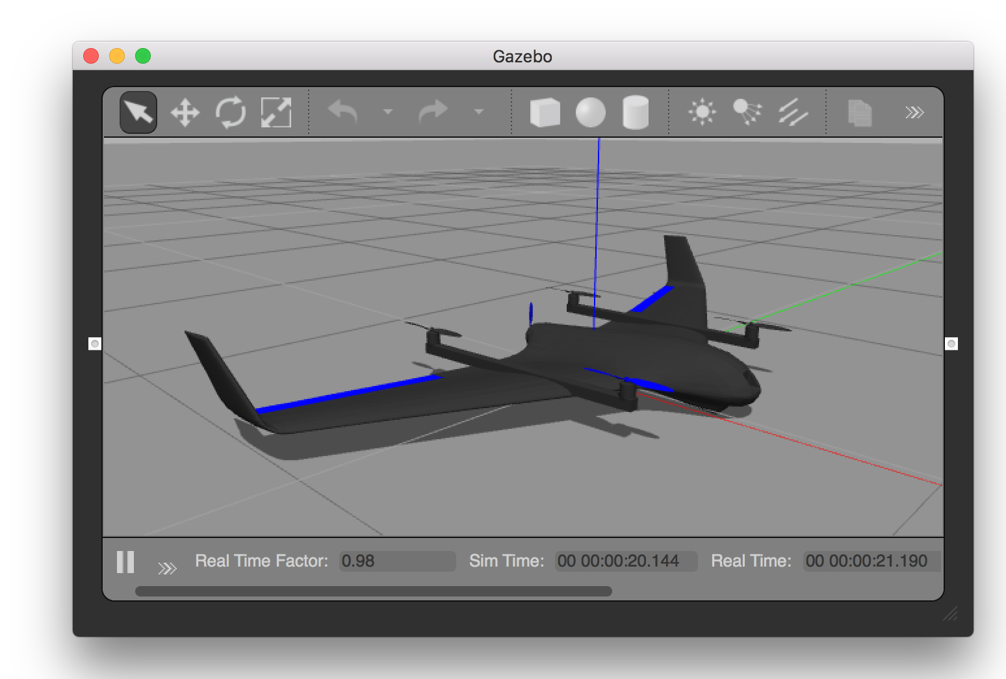
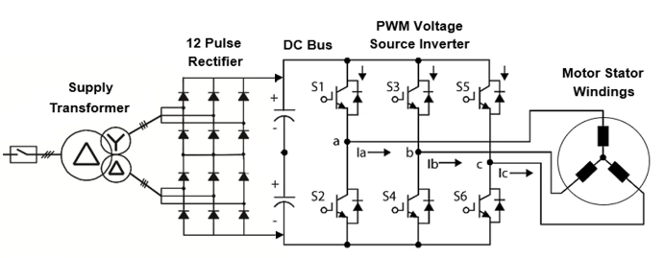
PX4 Transfer + VIBUM Product Development
PX4 Development (Transfer Tasks from Jeong Seok)
PX4 LQR Toolbox Development (On Going)
Simulation with GCS (Q ground control + Gazebo) (Finished)
Drone Assembling (Finished)
HITLs (On Going)
Digital Twin Tech with XR/Metaverse (Discussion need with Prof. Lee)
ADSP e-Propulsion (working with Nghia)
System Analysis for inverter PMSM motor (Discussion need with Dr. Irfan)

Slide 4
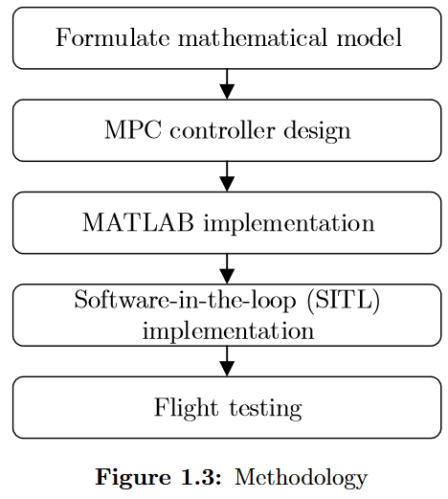
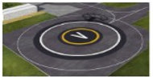
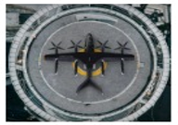
Academic Research
Personal Research (Part of ODT Project)
- Aircraft hardware and software fault diagnosis techniques and decision-making research
(Detail discussion needed with Prof. Lee)
- Design and Implementation of Model Predictive Control on Pixhawk Flight Controller for KP2
Conferences
Safety landing Vertiport with AI image-based method-KSAS (Dr. Sakthivel and Dr. Aye Aye Maw)
Publication
Study how to write an Academic Journals for personal research (Dr. Tuan)

